Slide 1
Week 1 & 2
DSC 640
Abed Tabbalat

Slide 2
Python

Slide 3

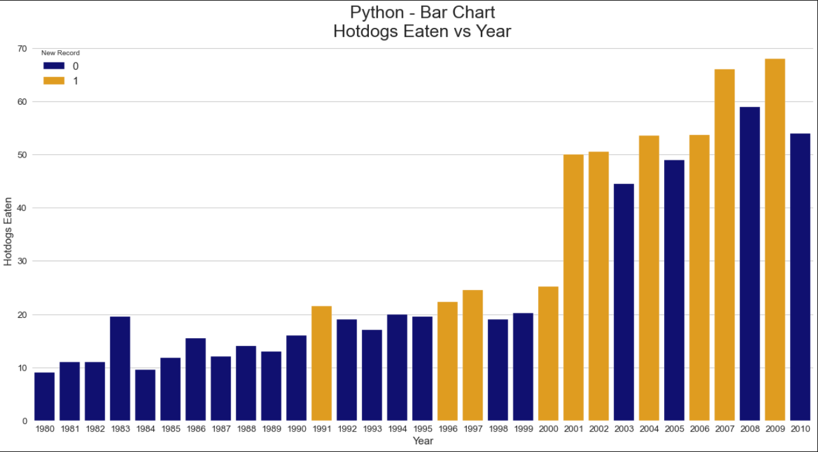
Python – Bar Chart

Slide 4
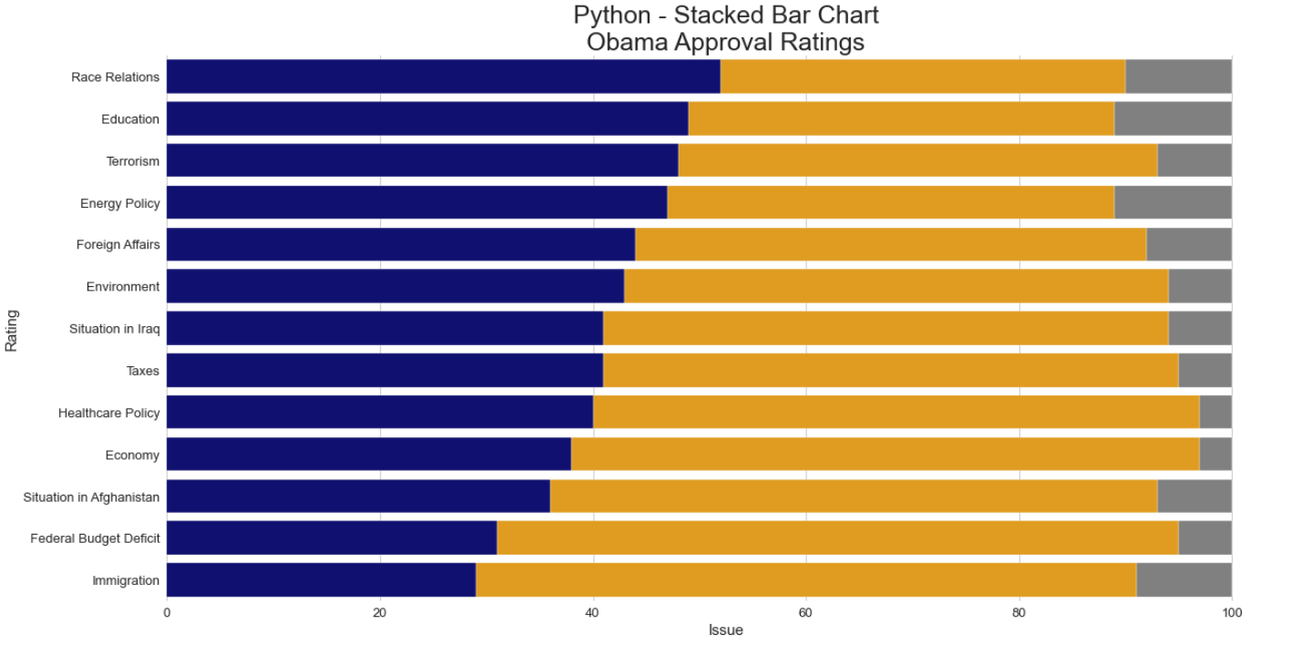
Python – Stacked Bar Chart

Slide 5
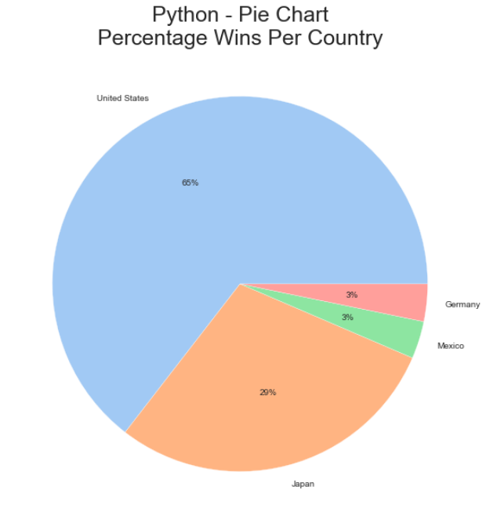
Python – pie chart

Slide 6
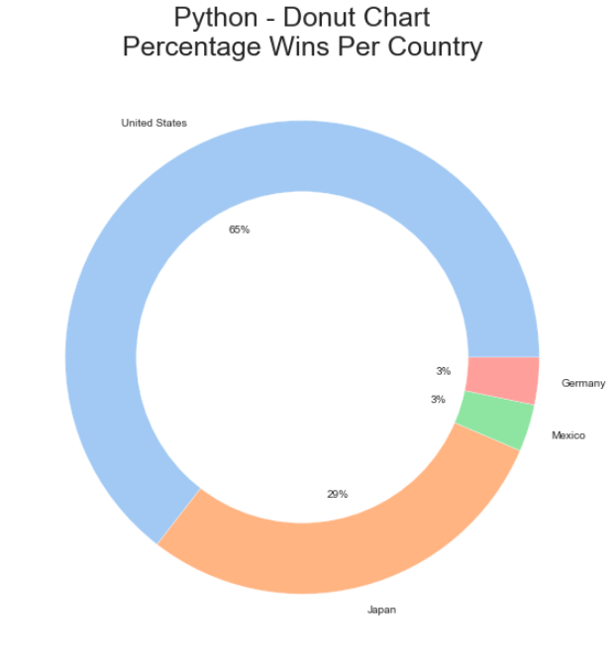
Python – Donut chart

Slide 7
R

Slide 8
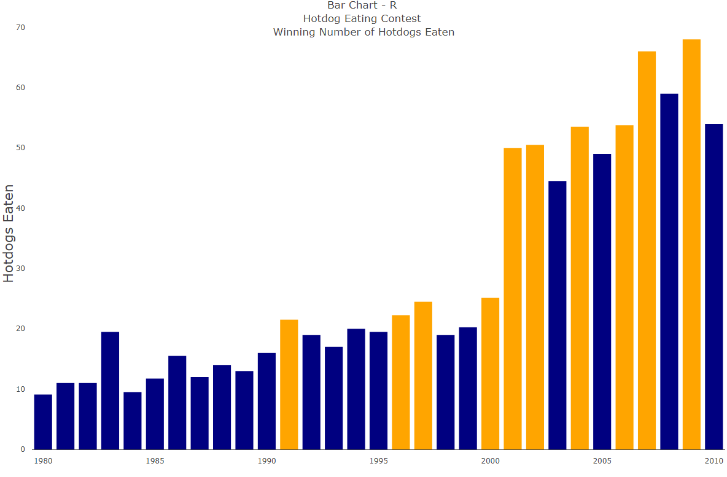
R – Bar Chart

Slide 9
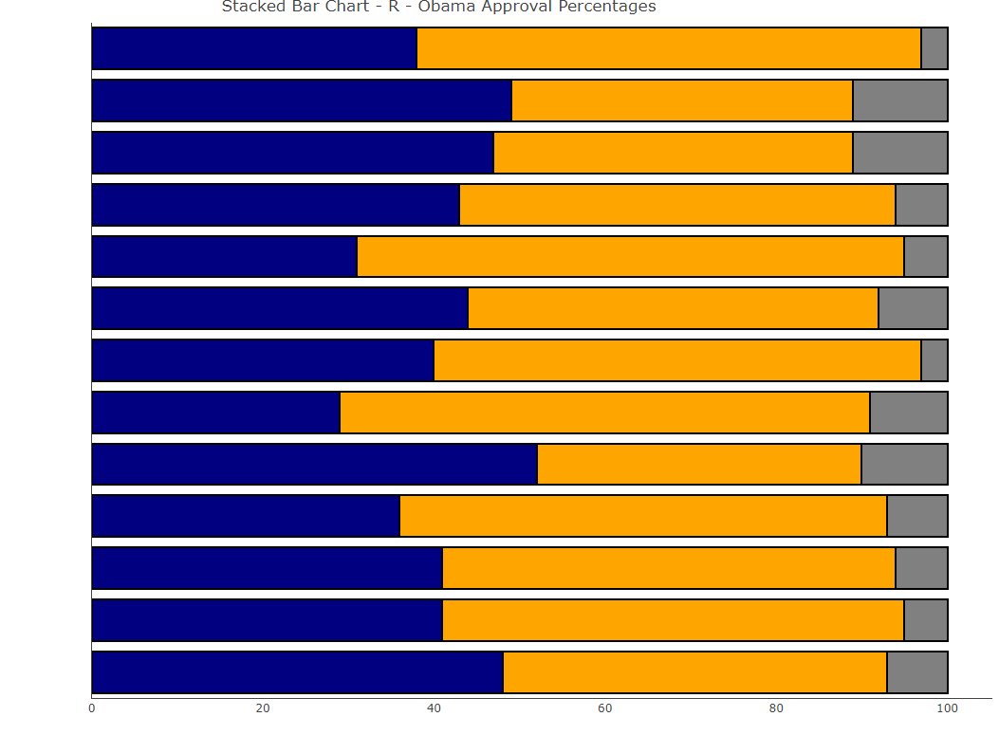
r – Stacked Bar Chart

Slide 10
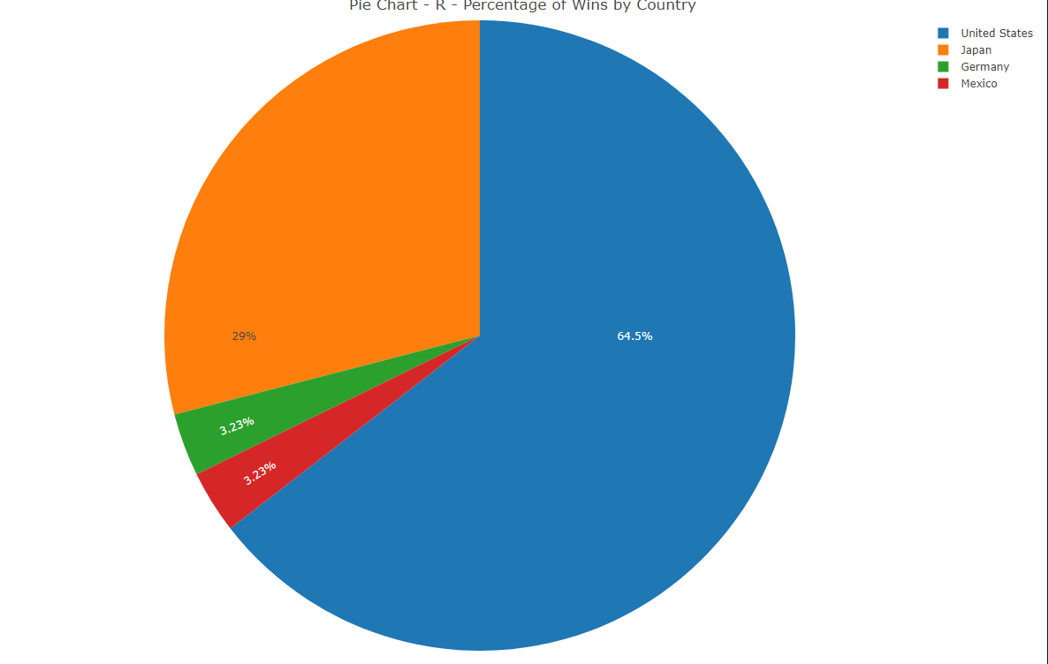
r – pie chart

Slide 11
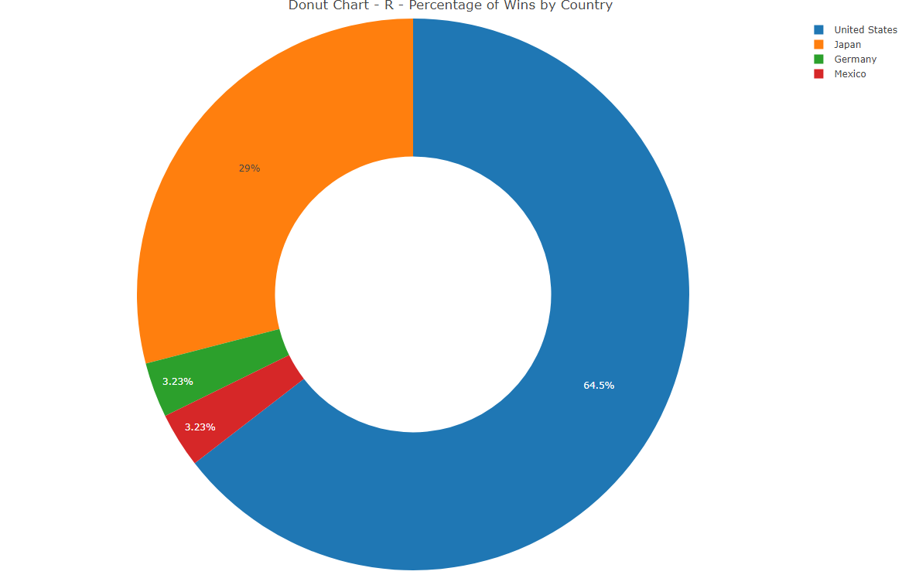
r – Donut chart

Slide 12
Tableau

Slide 13
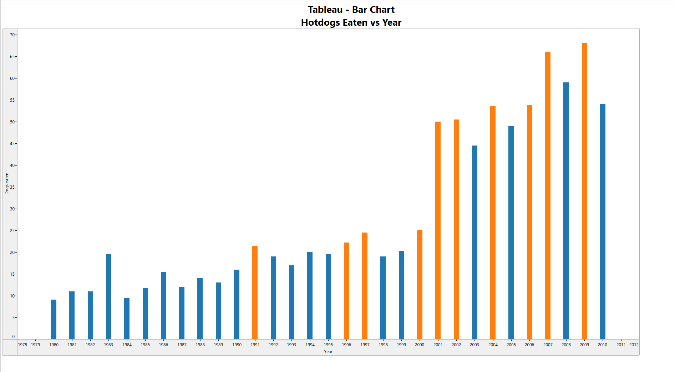
Tableau – Bar Chart

Slide 14
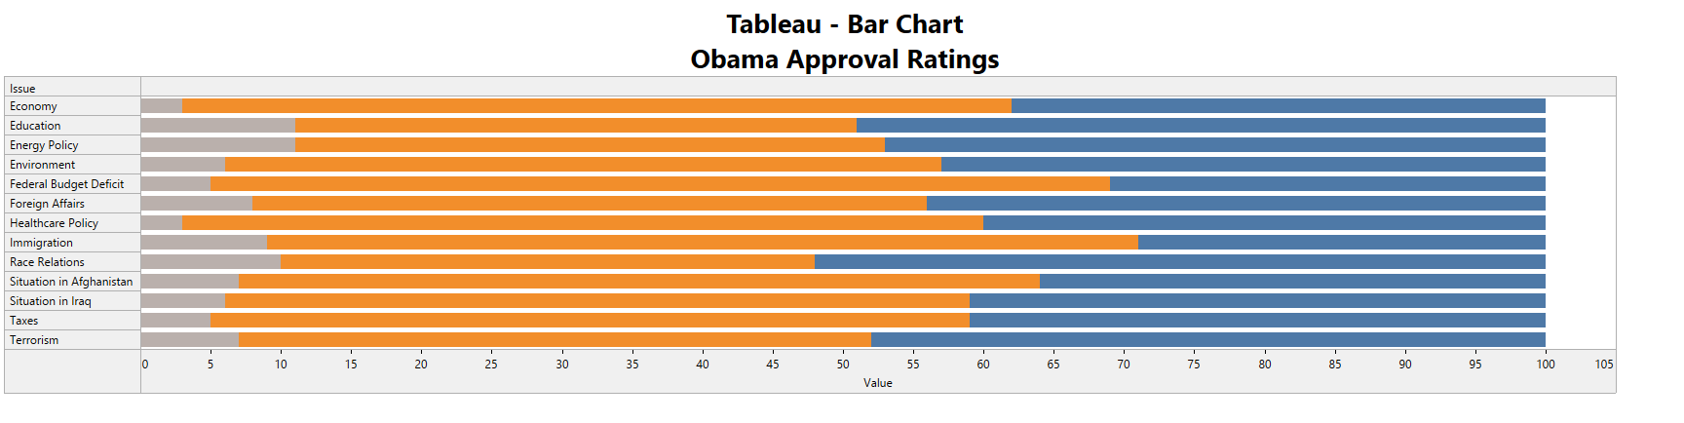
Tableau – Stacked Bar Chart

Slide 15
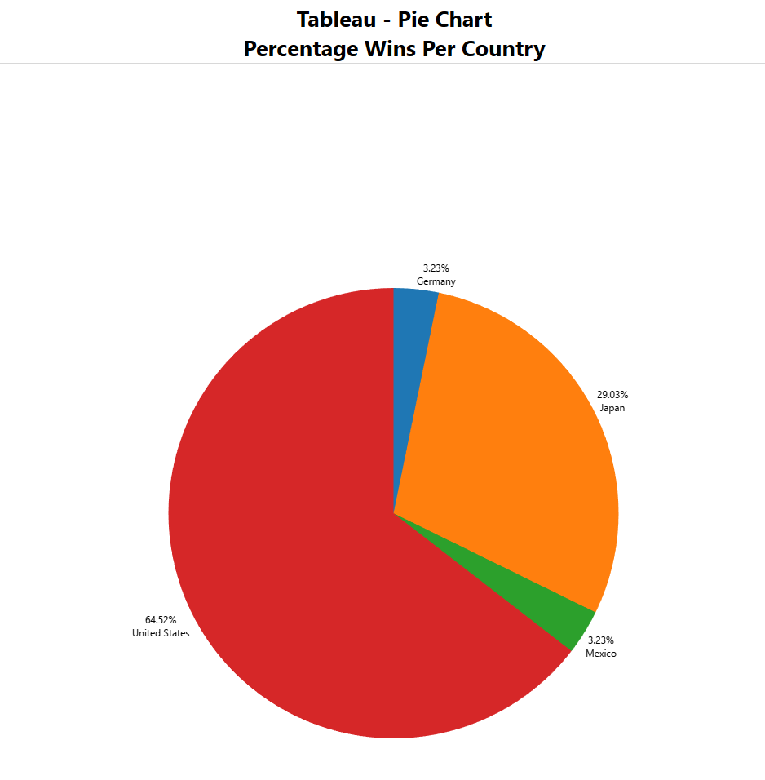
Tableau – pie chart

Slide 16
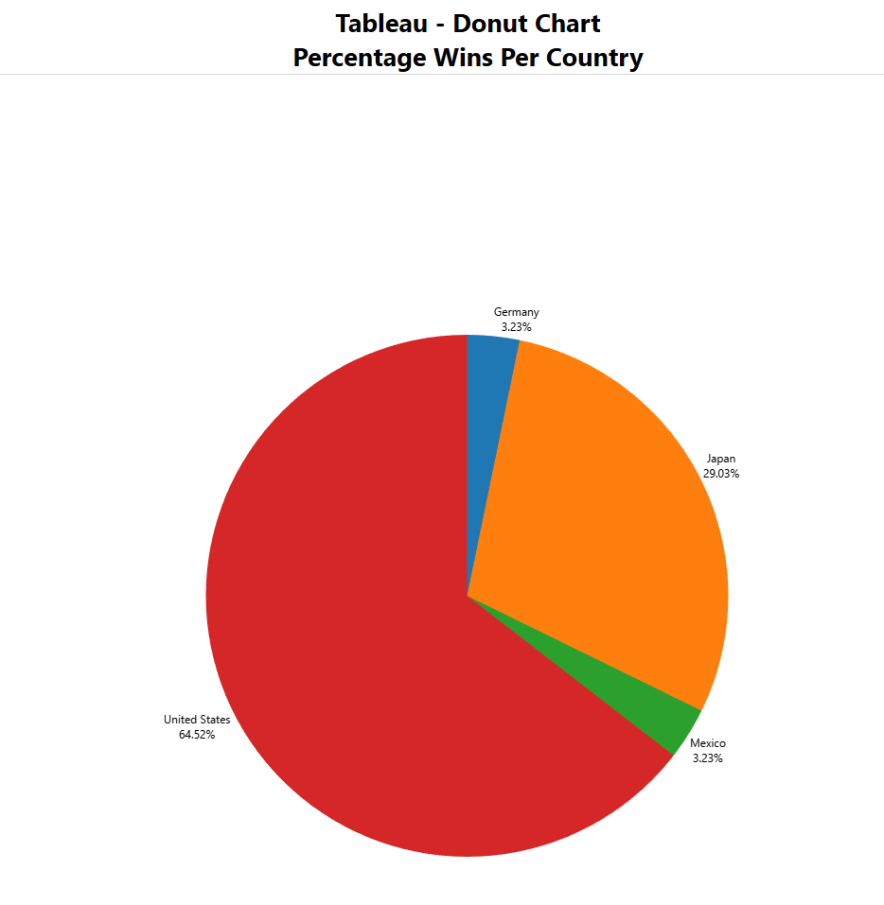
tableau – Donut chart

